Slide 1

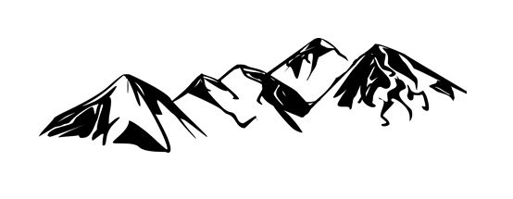
Landmarked
Disclaimer: We are not liable if you walk off a cliff or otherwise injure yourself.
User assumes all responsibility when using this application.
Kelly, Logan, Garrett, Junmin

Slide 2
Description
Mobile application to identify landmarks
Get landmark information by aiming phone at it
Store custom landmarks with personal notes
Track landmark history and popularity

Slide 3
As Timmy the user, I want to point my phone at a landmark and find information about it. -[Mobile App]

Slide 4
As Tommy the mountain hermit, I want to still be able to use the app even if I go months without internet access. -[Local Storage]

Slide 5
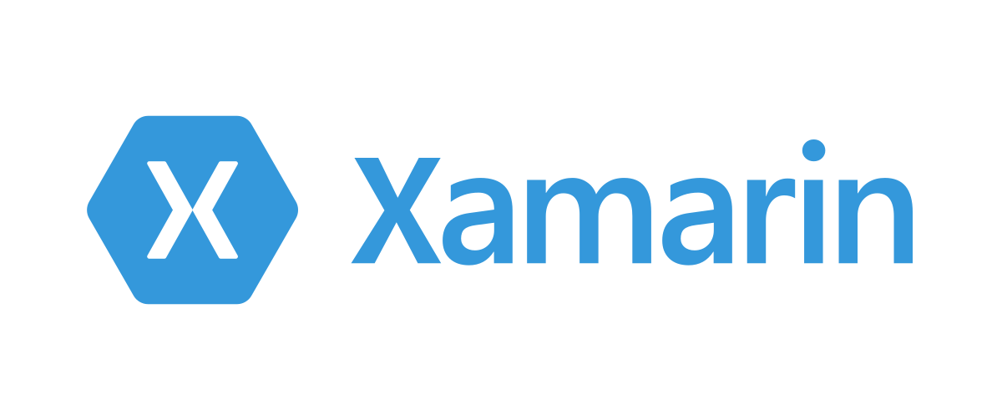
Xamarin
Language: C#
Pros
Lots of documentation
Free to us
Cons
Still has trouble getting it to work right

Slide 6

Unity
Language: C#
Pros
Readily available
Free version
Cons
Used more for games
Very resource intensive

Slide 7
Android Studio
Language: Java, C#, C++, etc.
Pros
Built-in emulator
Made by the android developers
Cons
Still will need to run on a real physical phone
Alienates going to IOS

Slide 8

Chosen Technology: Android Studio
Built-in phone emulator helps with running quick compilation and UI tests
Does favor Java but is still compatible with C languages and Kotlin
Reliable documentation by the Android developers

Slide 9
Questions?

Slide 10
As Gina the historian, I want some historical information about the landmark. -[Historical Information]

Slide 11

MediaWiki API
Pros
Able to pull information from Wikipedia
Easy to use and well documented
Cons
Not directly from Wikipedia, but the platform they are built on.
Requires a pre-fetch or internet access to function properly.

Slide 12
As Jane, a college aged woman, I want to share all my landmarks with my friends on social media. -[Social Media Integration]

Slide 13
As Rick the user, I’d like a nice measuring tool on the screen to help me pinpoint my target. -[Measurement Tool]

Slide 14
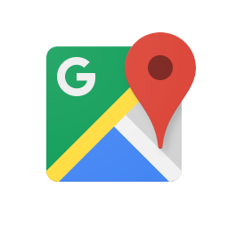
Google Maps Platform
Pros
Extensive information available
Most complete platform
Cons
Heavy cost
Might need to interact with multiple, separate APIs to obtain elevation data. This may increase overhead.

Slide 15

Bing Maps
Pros
Very well documented
Not as expensive as Google
Cons
Still relatively expensive
Resource intensive
Not as customizable

Slide 16

TomTom
Pros
Good cost structure (2500 free API calls/day)
Widely used
Has points of interest database
Cons
Daily calls will limit how much we can test in one day
General downward trend in popularity

Slide 17
Mapbox
Pros
Upward popularity trend
Cross-Platform
Cons
Rather resource intensive

Slide 18

Chosen Technology: Mapbox
Not unreasonably expensive
Free Tier
50k monthly active users
50k geocode requests / month
50k directions request / month
50k matrix elements / month
More beyond that point
Built in online maps
Points of Interest

Slide 19
Questions?

Slide 20
As Jimmy the user, I want some visual representations to appear on the screen as I dial in to a landmark -[Augmented Landmarks]

Slide 21
WPF/xaml
Language: C#
Pros
Well documented
Free for us
Cons
Customizing controls would take a long time

Slide 22
Java GUI
Language: Java
Pros
Easy to get started
Cons
Will have to integrate into other languages
Harder to fine tune UI as the project gets bigger

Slide 23

UX App
Language: HTML and CSS
Pros
Compatible with Photoshop
Gives user data to developers
Cons
Seems more for graphic designers than programmers
$$$

Slide 24
Chosen Technology: WPF/xaml
Easily expandable over time
No cost for us
Can easily integrate calls to other languages such as JavaScript for API calls

Slide 25
Questions?

Slide 26
As Billy the new user, I want to log into an account for this app. -[User Accounts]

Slide 27
As Tina the fisherman I want to privately save a great spot I found that so I can get back to it in the future. -[Custom Landmarks]

Slide 28
As Kara the dedicated user, I want to save my landmarks online so I can access them from another device. -[Saved Landmarks]

Slide 29
As Nancy the frequent user, I want to have a list of all the landmarks I’ve visited. -[Landmark History]

Slide 30

As Dora the explorer, I want to save personal notes about my trips to landmarks so that Swiper doesn’t swipe them. -[Saved Notes]

Slide 31
As George the photographer, I want all the pictures taken at each location to be associated with the location they were taken at. -[Associated Photos]

Slide 32
As Francine the world traveler, I want to easily show my friends a quick slideshow style summary of all the places I’ve been. -[Slideshow Summary]

Slide 33
As Hannah the avid hiker, I want to rate locations so that newcomers to the area know where to go. -[Rating System]

Slide 34
As Dan the introverted hiker, I want to know the traffic of a landmark so that I can avoid busy places. -[Popularity System]

Slide 35

Oracle Database
Pros
Modern/Latest Features
Versatile
Cons
Requires significant resources
$$$$$

Slide 36

MS SQL Server
Pros
Free Edition
Widely supported
Secure
Cons
Windows-Only
Requires Windows machine for deployment

Slide 37

MySQL
Pros
Free
Functional
Cons
Takes longer to implement

Slide 38

PostgreSQL
Pros
Supports JSON
Database management can handle TBs of data
Cons
Lack of documentation
Confusing configuration
Slower speed during bulk operations

Slide 39
Chosen Technology: MS SQL Server
No cost!
Secure for accounts
Enhanced performance

Slide 40
Questions?

Slide 41
Thank you!

